Slide 1
Module 2 Introduction to Databases and DBMSs
Lesson 4: Non-Procedural Access
Notes:
Welcome to Lesson 4 of Module 2 on the Introduction to Databases and DBMSs
- Covers non-procedural access, the most important feature of a DBMS
Database management systems are vital technology to modern organizations
Opening question:
What is the most labor intensive part of software development? Coding loops
How many orders of magnitude improvement of development time from non procedural access?

Slide 2
Lesson Objectives
Discuss importance of non-procedural access
Explain features commonly found in client tools for database retrieval
List reasons for using a database programming language
Notes:
Conceptual lesson
No detailed skills in this lesson
Install and explore client tools for Oracle and PostgreSQL

Slide 3
Non-procedural Database Access
Loop
Query: request for data to answer a question
Indicate what parts of database to retrieve not the procedural details
Improve productivity and accessibility
SQL SELECT statement and graphical tools
Notes:
Specify what not how
Loop buster: no loops; major difference between procedural and nonprocedural language
Trip planning analogy: specify features of trip (destination, quality of accommodations, dates, …) but not details (route, hotel research, flight research, …)
Productivity improvement: 100 times fewer lines of code

Slide 4
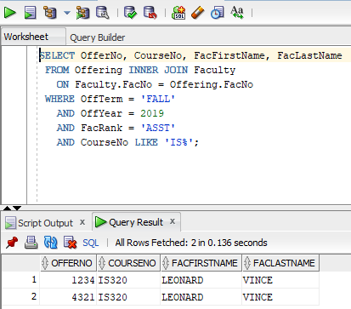
Worksheet Tool in SQL Developer
Notes:
Execution of SELECT statement in the SQL Developer
Combining the Offering and Faculty tables
The snapshot shows an SQL SELECT statement executed with generated rows in the bottom of the snapshot. The SELECT statement of SQL, described in modules 4 and 5, provides a nonprocedural way to access a database. Buttons in the Worksheet window support statement execution, history of statements executed, making changes permanent, undoing changes, erasing window content, and other functions.

Slide 5
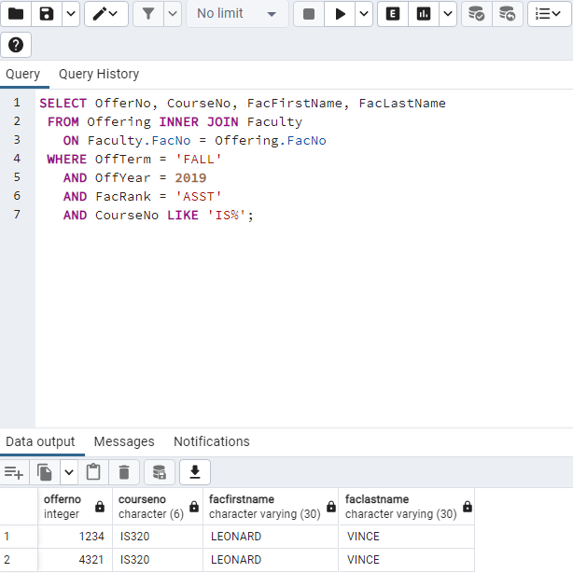
Query Tool in pgAdmin
Notes:
Execution of SELECT statement in the pgAdmin client
Combining the Offering and Faculty tables
This snapshot shows an SQL SELECT statement executed with generated rows in the bottom of the snapshot. Buttons in the Query Tool window support statement execution, history of statements executed, saving statements, editing statements, and other functions.

Slide 6
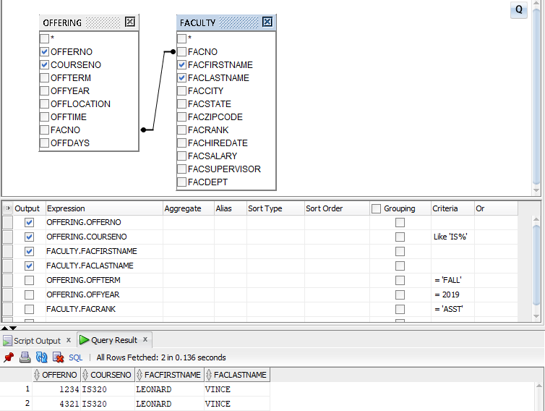
Query Builder Tool in SQL Developer
Notes:
Query Builder (Oracle)
- specify tables and columns
- Oracle determines connections among tables

Slide 7
Database Programming Languages
Combine procedural language with non-procedural access
Why
Batch processing especially big data tasks
Customization especially for ecommerce and automation
Modularization
Notes:
Combine external languages (COBOL, Java, C, C++, …) with SQL
New DBMS specific languages: PL/SQL (Oracle), Transact-SQL (SQL Server)
Batch processing: much business processing is batch (collect loan applications and process together); online processing is becoming more prevalent because of the web; important for big data tasks
Customization: customize the behavior of a data entry form
Automation: rule processing; check qoh when an order is placed
Modulization: database processing in stored procedures managed by a DBMS

Slide 8
Summary
Database technology vital to modern organizations
Non-procedural access as crucial DBMS feature
Database retrieval using SQL and database client tool
Database programming languages for big data tasks and customization of applications
Query formulation as a fundamental skill for information technology professionals
Notes:
DBMS are very complex products
Devote many years to understand a particular product
Learn fundamental skill of query formulation
Detailed skill that requires lots of practice
Use standard database language (SQL) in modules 3 to 5

